Slide 1



Slide 2

Semester Project
Presented By:
FA20-BSE-146 M. Arsalan Javaid
FA20-BSE-052 M. Mobeen
FA20-BSE-141 Ahmed Raza
SP21-BSE-052 Amir Khan
Presented To:
Dr. Wasif Nisar

Slide 3


Project Introduction
Mental Health as an emerging problem in Pakistan
The suicide rate among men is two to three times higher than among women. It is believed that mental illness will be among the leading causes of death by 2030.
According to one estimate, around 50 million people in Pakistan suffer from mental disorders.
According to one estimate, 36 percent of Pakistanis suffer from anxiety and depression, which is often caused by strained family and friend relations, the feeling of not fitting in the society, the unstable economic and political conditions of the country giving rise to unemployment and poverty.

Slide 4
Project Scope
The purpose of this management system is to help those individuals, teenagers who are suffering from anxiety, depression, and other mental diseases.
We want to minimize the efforts of a patient who will continuously go for checkup to the hospital and this management system provides an easy way to communicate with the doctor and the doctor will monitor the patient.
The scope of this management system is to provide benefits to the patient and save their time and efforts so they will be cured as early as possible.

Slide 5
OUR MISSION
The mission of our Mental Health Management System is to ease the patients and bring smile on their faces.
The tagline of this application is giving hope to those patients whose life is dull because of depression, stress and anxiety.
Our Tagline => “You will smile again”.

Slide 6
Project Features
DOCTOR
Login/Registration Page
To Review patient’s questionnaires result
Help patient through chatbox
PATIENT
Login/Registration Page
Disease Selection for Questionnaire
Disease Level
Medication
Meditation
Chatbox to communicate to the doctor

Slide 7
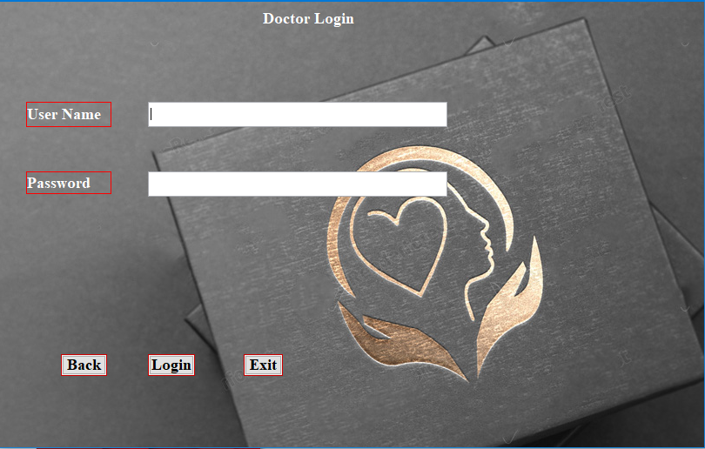
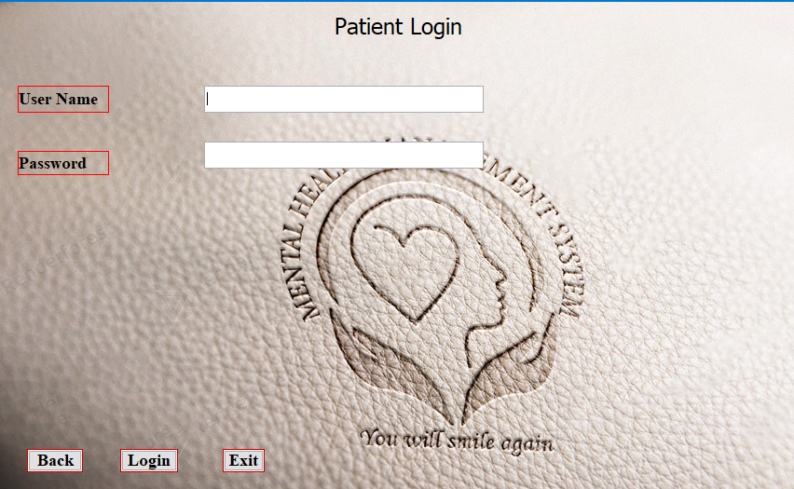
Login/registration
Doctor
Patient

Slide 8
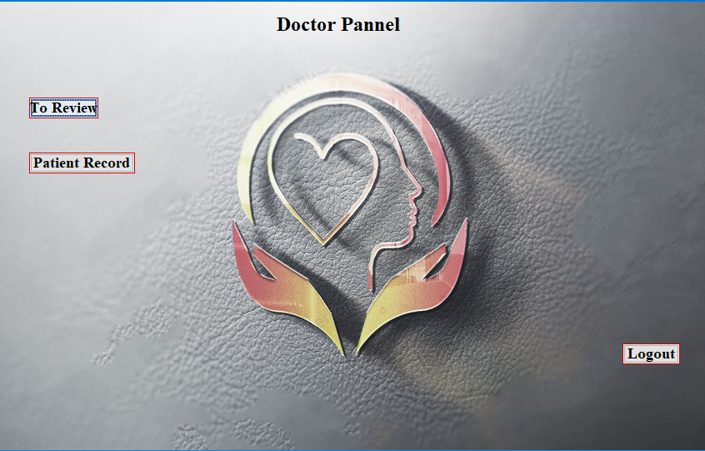
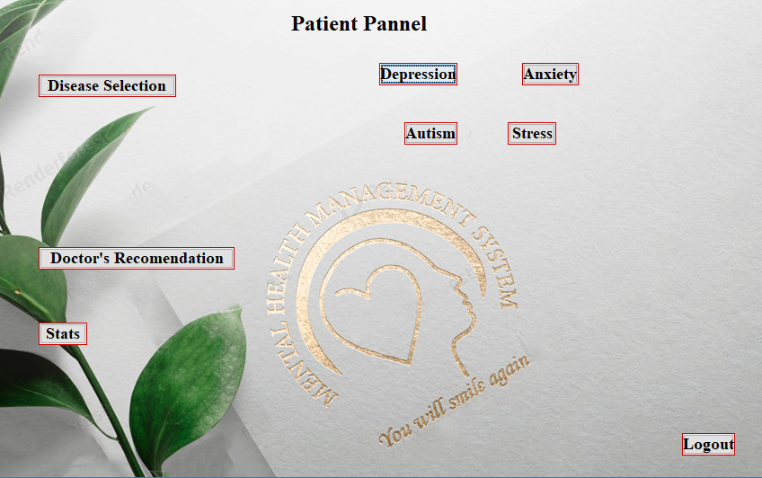
Dashboards

Slide 9
Project working
Patient
The Patient will login using his/her username and password.
Successful login will take the patient to the dashboard.
The patient will select the disease which he/she is suffering from.
After disease selection, the patient will attempt questionnaire and then submit it.
Medications and Meditation will appear according to the disease level of patient.
The patient can further get assistance from the doctor, if necessary, through chatbox.

Slide 10
Project working
Doctor
The Doctor will login using his/her username and password.
Successful login will take the doctor to the dashboard.
The doctor will review the questionnaires attempted by the patients.
The doctor can access the records of previous patients.
The doctor will communicate to the patient through chatbox.

Slide 11
Requirement engineering of our project
We gathered all the requirements after communicating with each other.
After joint discussion, we made a product backlog of all the requirements needed to make this project happen.

Slide 12
Our project in terms of software engineering
Our project is made according to the following phases of software development life cycle:
Planning
Communication
Designing
Construction
Testing
Deployment

Slide 13
Process models used in our project &WHY?
The incremental model was used by us in developing our management system.
The reason for using this model was that as we were newcomers in developing a java application, so we divided the project among ourselves which resulted in many increments.
The flow of our management system is iterative.
Our flow is iterative because as newbies we made many mistakes while developing the application. This resulted in redirecting from one module into module.

Slide 14
Process models not used in our project & why?
Linear model was not used because frequent iterations are not possible in it.
Agile Methodology was not used because our project was not a high-level project.
Evolutionary model was not used because if we needed to change something, we had to complete a cycle and then move to that specific module to change it.

Slide 15
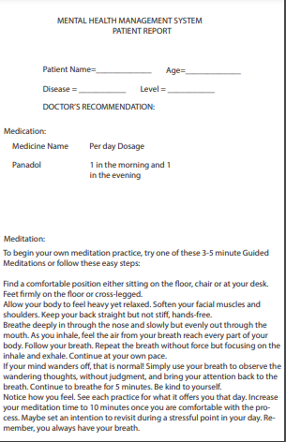
Designing phase of our project
We used Adobe Illustrator for making logo of our application.
We also used Adobe Illustrator for prototyping of our interfaces.
We have used NetBeans IDE 8.2 for making our final GUIs.
The backgrounds used in the application are basically mockups in which we put the logo. Adobe Photoshop was used for this purpose.

Slide 16
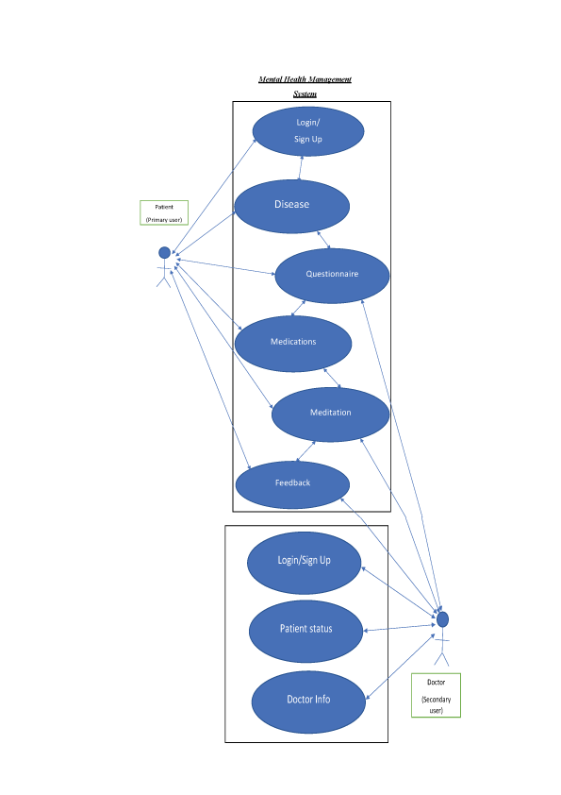
visual representation of our project
USE CASES:
Primary User→ Patient
Secodary User→ Doctor
Flowlines are used to relate
features with their actors.

Slide 17
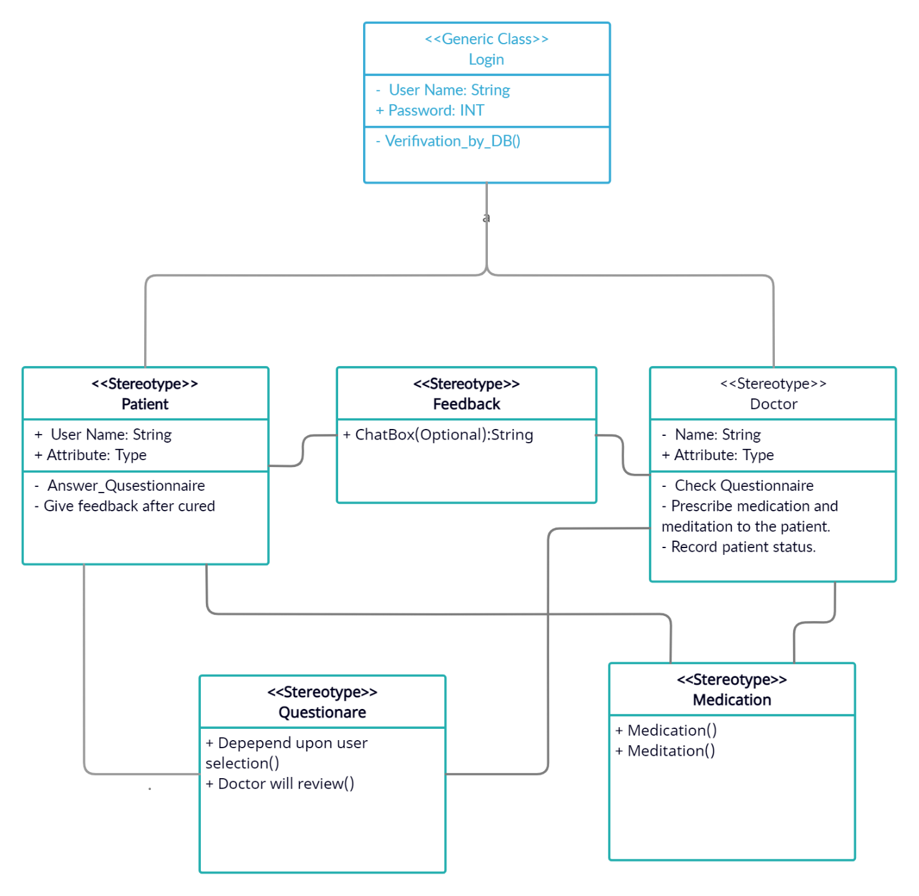
visual representation of our project
CLASS DIAGRAM:
Two classes of users
Doctor & Patient
Attributes
Functionality
Cardinalities

Slide 18
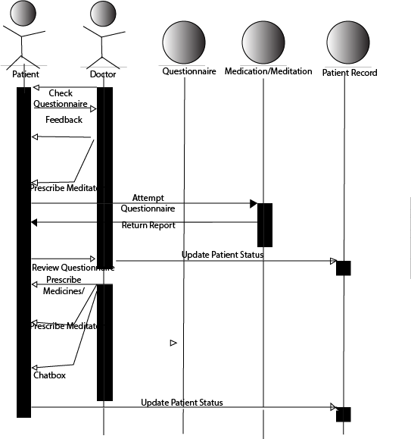
visual representation of our project
SEQUENTIAL DIAGRAM:
Actors
Association
with features
Behavior

Slide 19
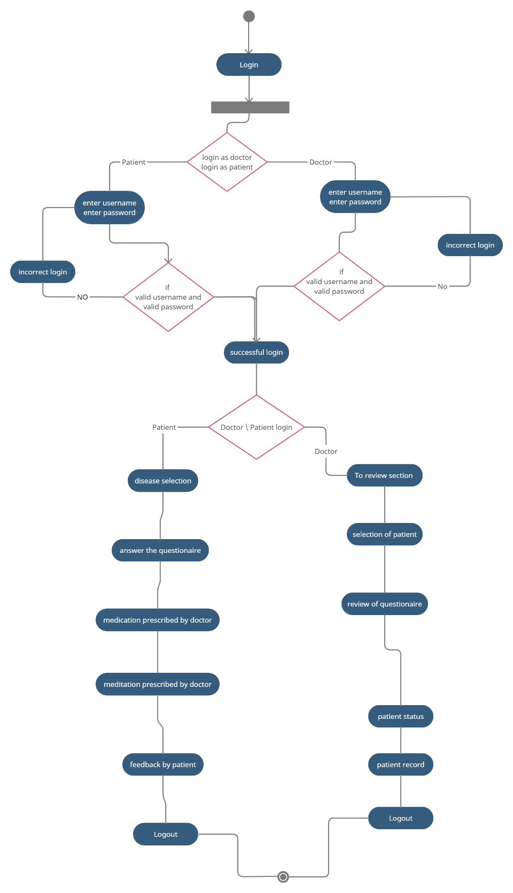
visual flow of our project
COMPOSITE DIAGRAM:
This diagram is showing us the overall flow of our application.
Starting from the login to logout all the flow is represented here.
Following notations are used here:
Start
Action
Decision
Flowlines
End

Slide 20
RISK Management in our project
Basic Risks faced by us during development phase of our application:
Time management
Lack of Skills
Lack of Database Knowledge
Hardware issue
Data loss

Slide 21
RISK Management in our project
Basic Risks faced by us during construction phase of our application:
Interface Linking
Questionnaire Logic
Patient Doctor Communication

Slide 22
RISK Management in our project
External Risks
Launching of our software in the market.
Software environment Issues.
Doctors can stop us because they think that physical interaction with patients is more beneficial than online consultation.
Patients facing these problems don’t talk about these diseases openly with anyone.

Slide 23
Conclusion
We have made an effort to make those people smile who have forgot the meaning of life.
How we can play our part in the society to reduce this problem?
“Transfer your pain to the pages”

Slide 24
Thank you

